Slide 1

3D & 4D Reconstruction
using
Gaussian Splatting
Alvaro RIBAS, Gustavo PAULINO, Leevan BEAUSOLEIL | Mindèris KRIR
IMA4202 – Computer Vision & Deep Learning, Part 2

Slide 2
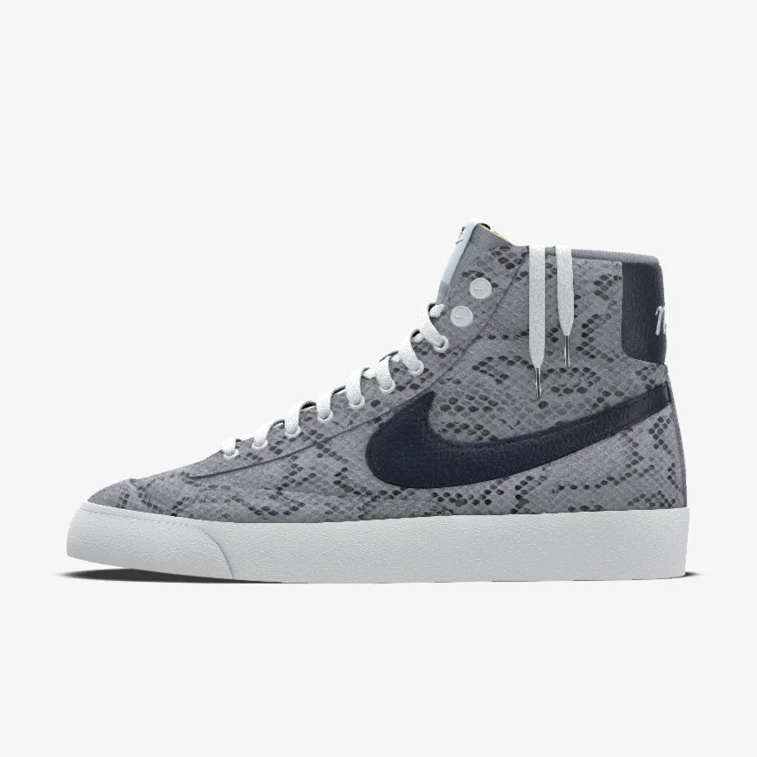
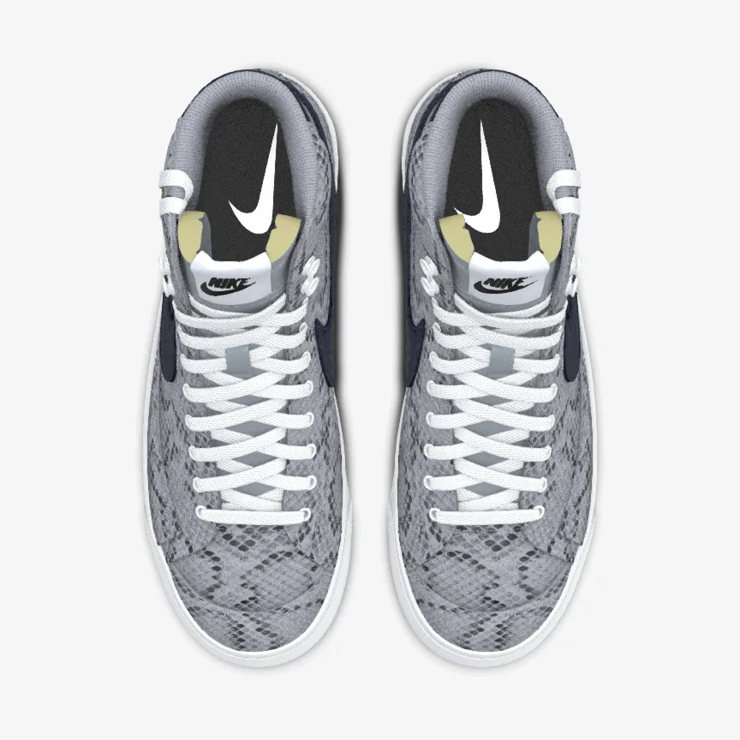
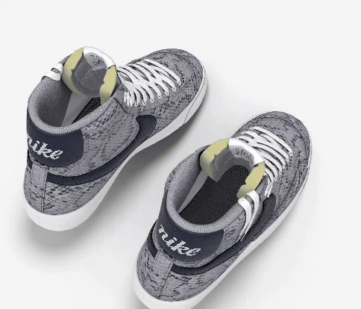
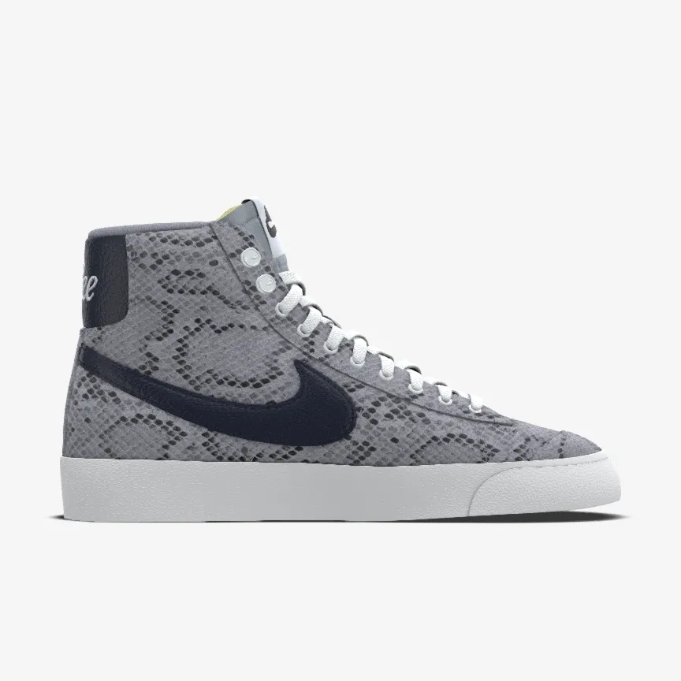
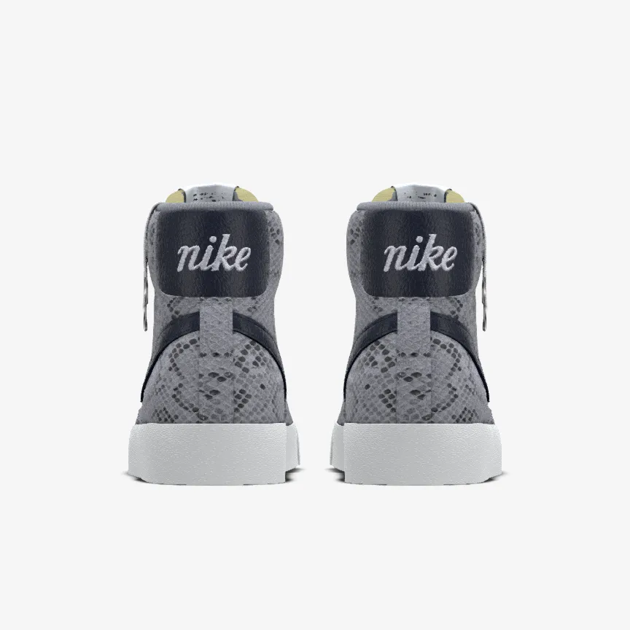
Introduction
Set of 2D images
3D reconstruction

Slide 3
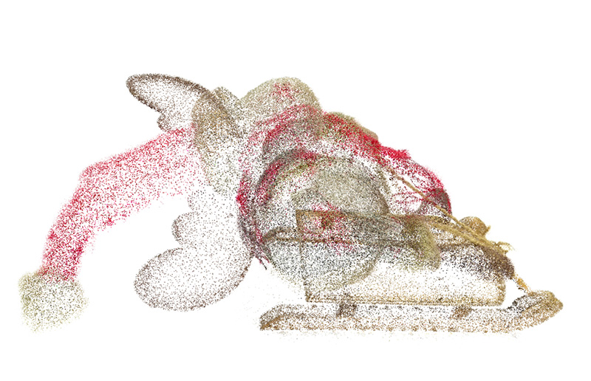
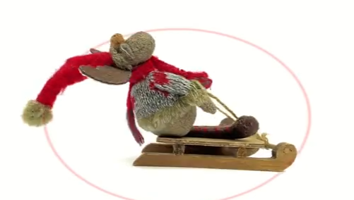
Introduction – 3D Gaussian Splatting
Begin: collection of points
End: Interactive 3D model
A. Carlier, “3D Gaussian Splatting Tutorial: Train and Visualize”, Reshot.ai, 2023;

Slide 4
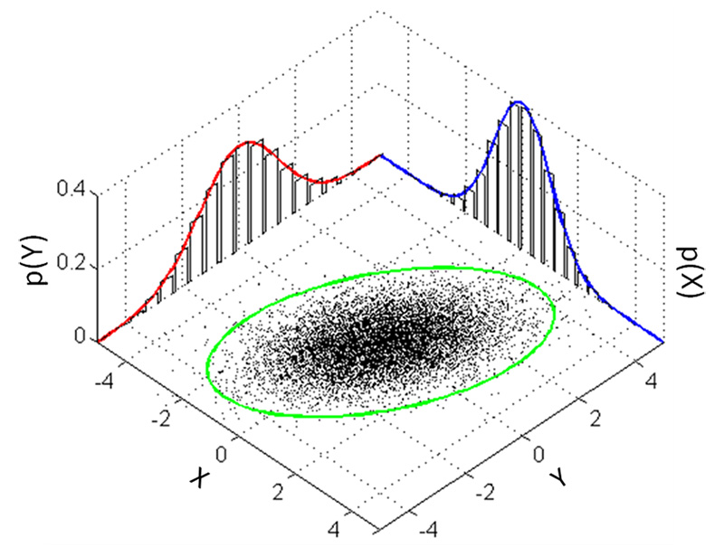
Introduction – 3D Gaussian Splatting
Center and three axes
Begin: collection of points
Rotation & translation
End: Interactive 3D model
Color and opacity
A. Carlier, “3D Gaussian Splatting Tutorial: Train and Visualize”, Reshot.ai, 2023;

Slide 5
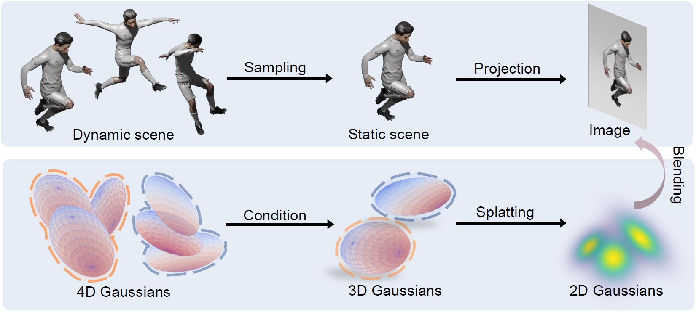
Introduction – 4D Gaussian Splatting
L. Zhang et al., “Real-time Photorealistic Dynamic Scene Representation and Rendering with 4D Gaussian Splatting”, from arXiv, 2024;

Slide 6
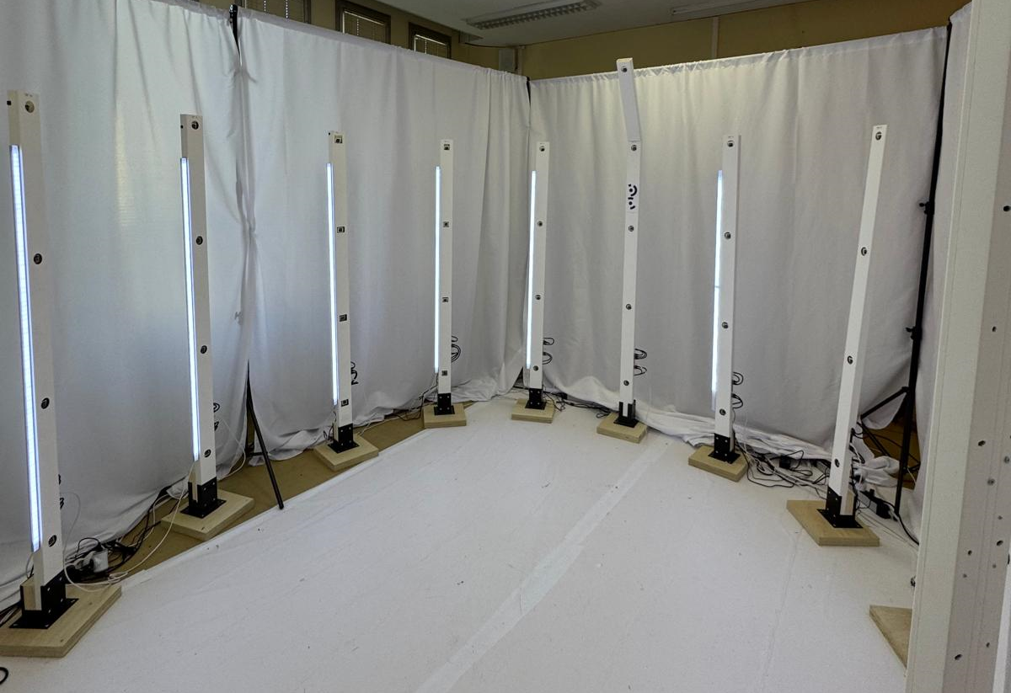
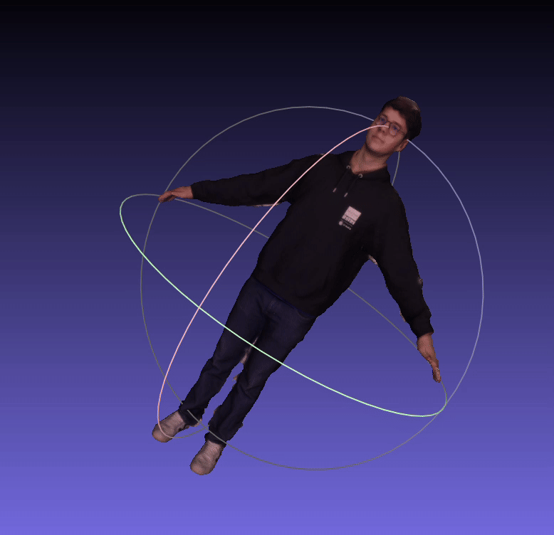
Implementation and first experiments
1. Textured image (mesh)
Capture studio @ Artemis, Télécom SudParis
Photogrametry

Slide 7
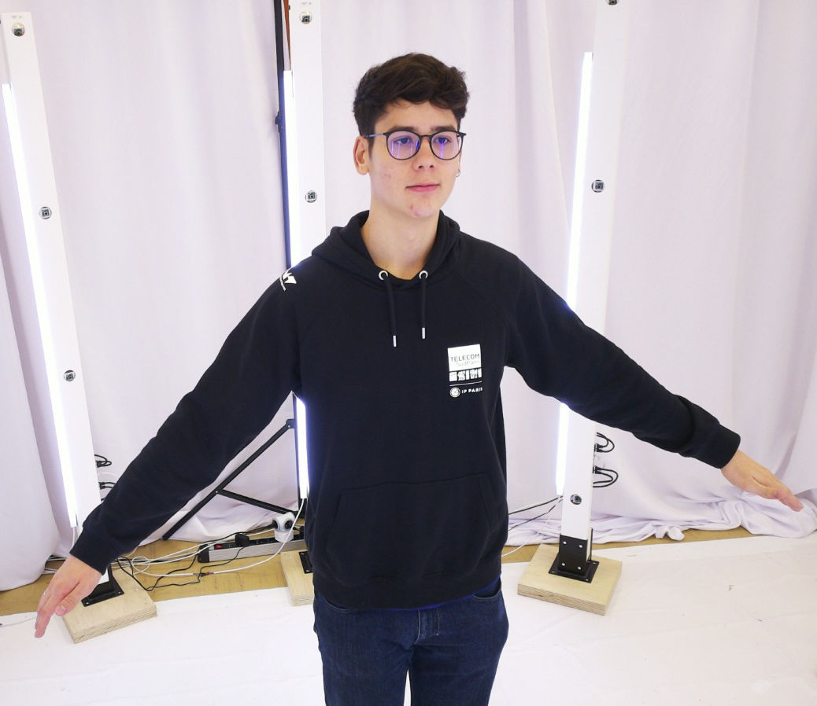
Implementation and first experiments
2. 57 synchronous images
Capture studio @ Artemis, Télécom SudParis
Gaussian Splatting

Slide 8
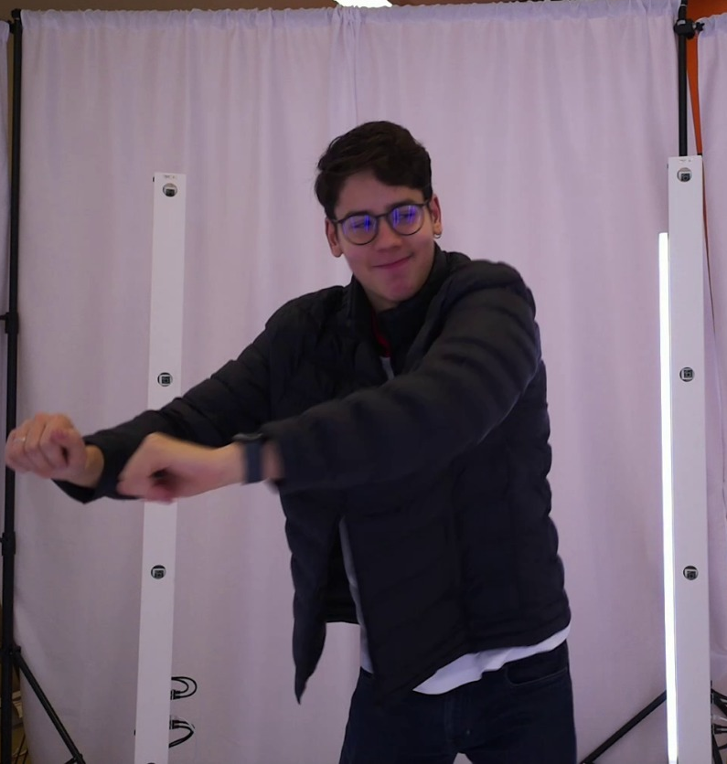
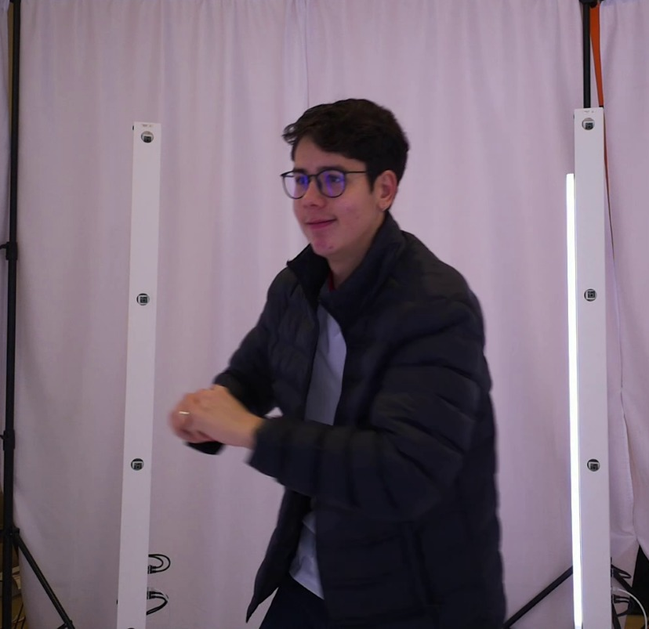
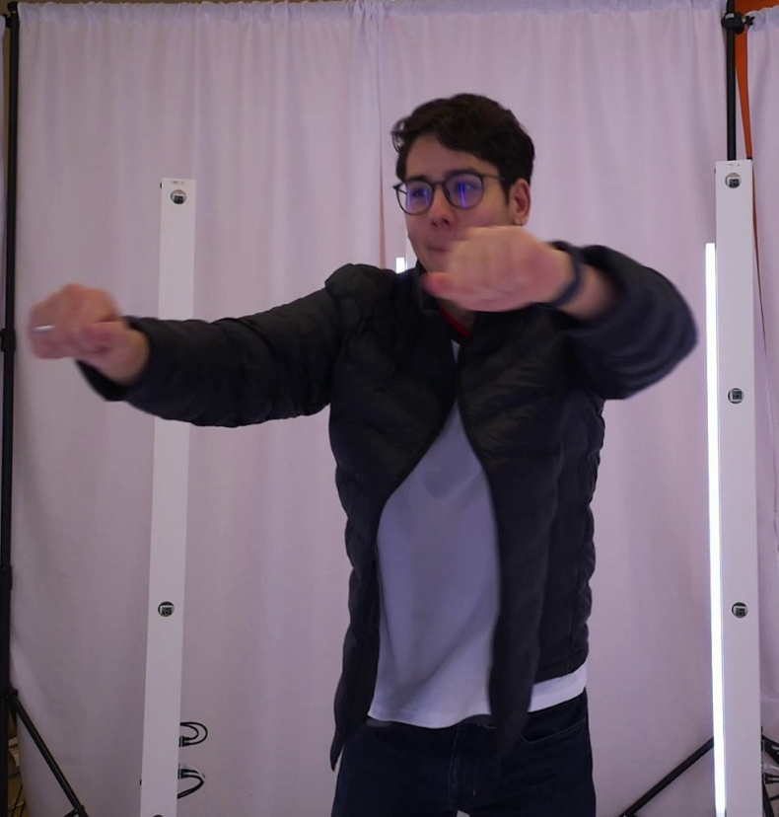
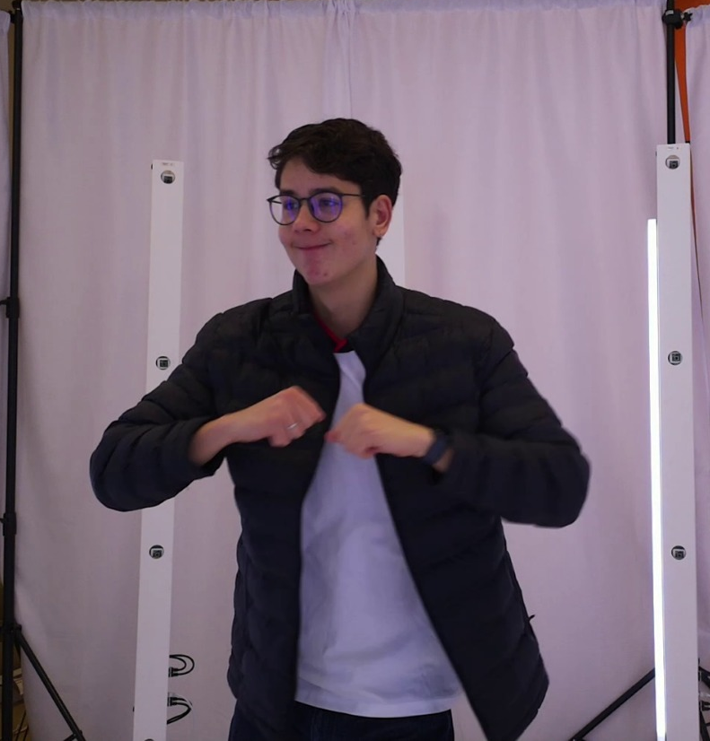
Implementation and first experiments
3. 57x(FPSxT) images to produce a sequence
4D Gaussian Splatting dataset

Slide 9
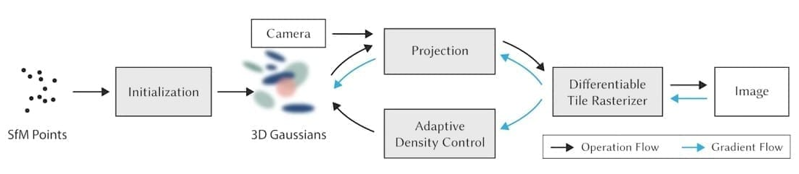
Implementation and first experiments
B. Kerbl et al., “3D Gaussian Splatting for Real-Time Radiance Field Rendering”, ACM Trans. Graph., vol 42, nº4, 2023;

Slide 10
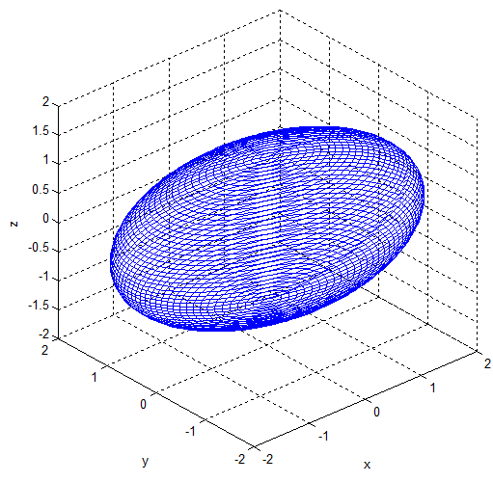
Implementation and first experiments
Camera
Projection
Initialization
Differentiable Tile Rasterizer
Image
SfM points
Adaptative Density Control
3D Gaussians
B. Kerbl et al., “3D Gaussian Splatting for Real-Time Radiance Field Rendering”, ACM Trans. Graph., vol 42, nº4, 2023;

Slide 11
Implementation and first experiments
Camera
Projection
Initialization
Differentiable Tile Rasterizer
Image
SfM points
Adaptative Density Control
3D Gaussians
B. Kerbl et al., “3D Gaussian Splatting for Real-Time Radiance Field Rendering”, ACM Trans. Graph., vol 42, nº4, 2023;

Slide 12
Implementation and first experiments
Camera
Projection
Initialization
Differentiable Tile Rasterizer
Image
SfM points
Adaptative Density Control
Color and opacity gradients
Spacial positions
Covariance matrix
3D Gaussians
B. Kerbl et al., “3D Gaussian Splatting for Real-Time Radiance Field Rendering”, ACM Trans. Graph., vol 42, nº4, 2023;

Slide 13
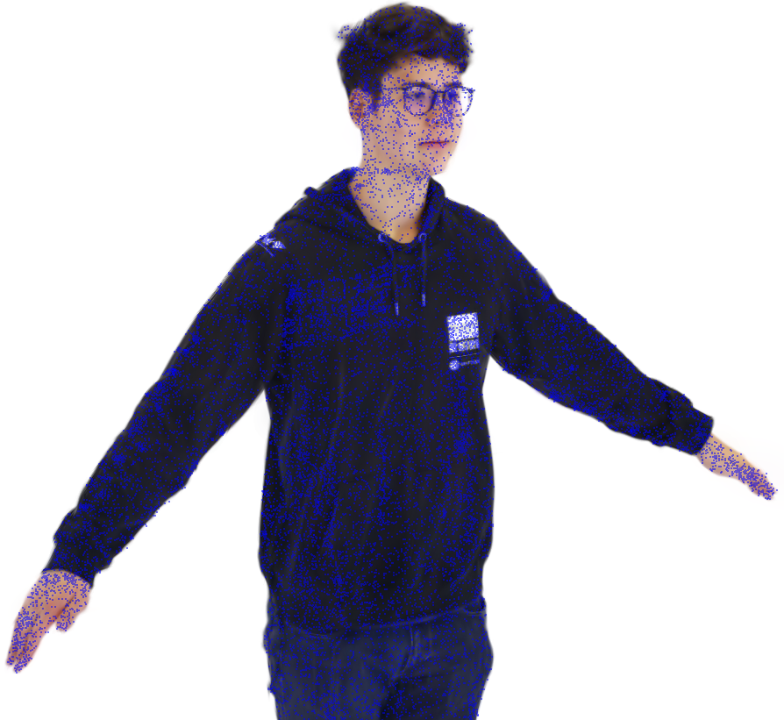
Structure for Motion (SfM)
Salient points
Projected points
Camera A1
Camera C1
Camera B1

Slide 14
Structure for Motion (SfM)

Slide 15
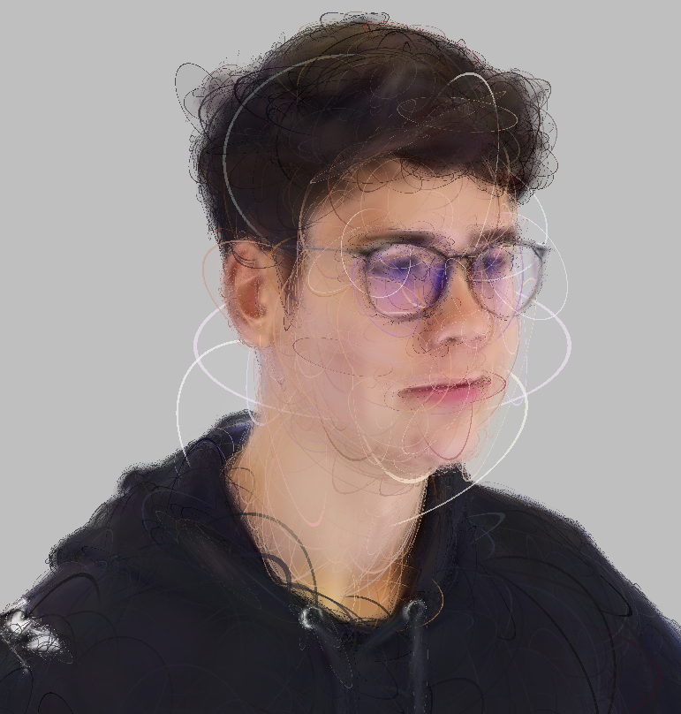

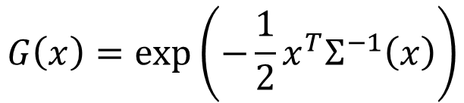
Construction of a sparse cloud
Sparse points: set of spacial points that don’t have normals and aren’t correlated.
$$G\left(x\right)=\exp\left(−\frac{1}{2}x^{T}Σ^{−1}\left(x\right)\right)$$
where $Σ$ is the covariance matrix.
3D elipses represented in the rendering

Slide 16
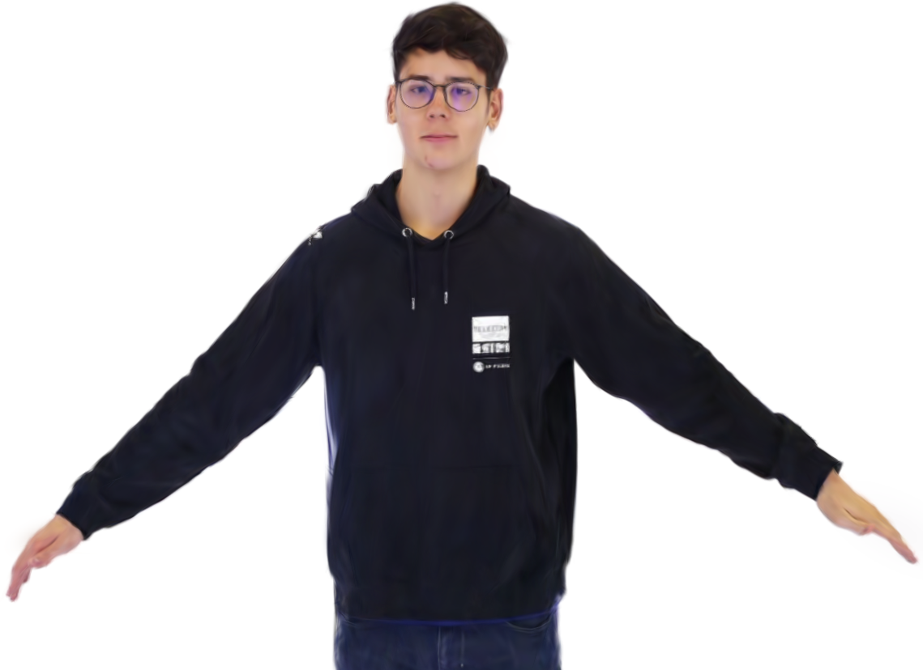

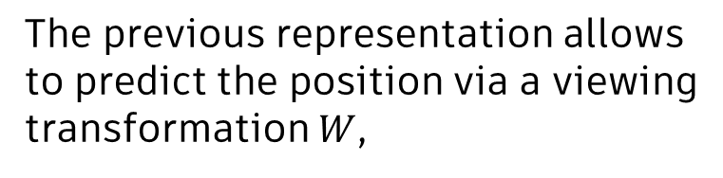
Defining camera position
The previous representation allows to predict the position via a viewing transformation $W$,
$$Σ^{′}=\left(JW\right)Σ{(W}^{T}J^{T})$$
Camera C1

Slide 17
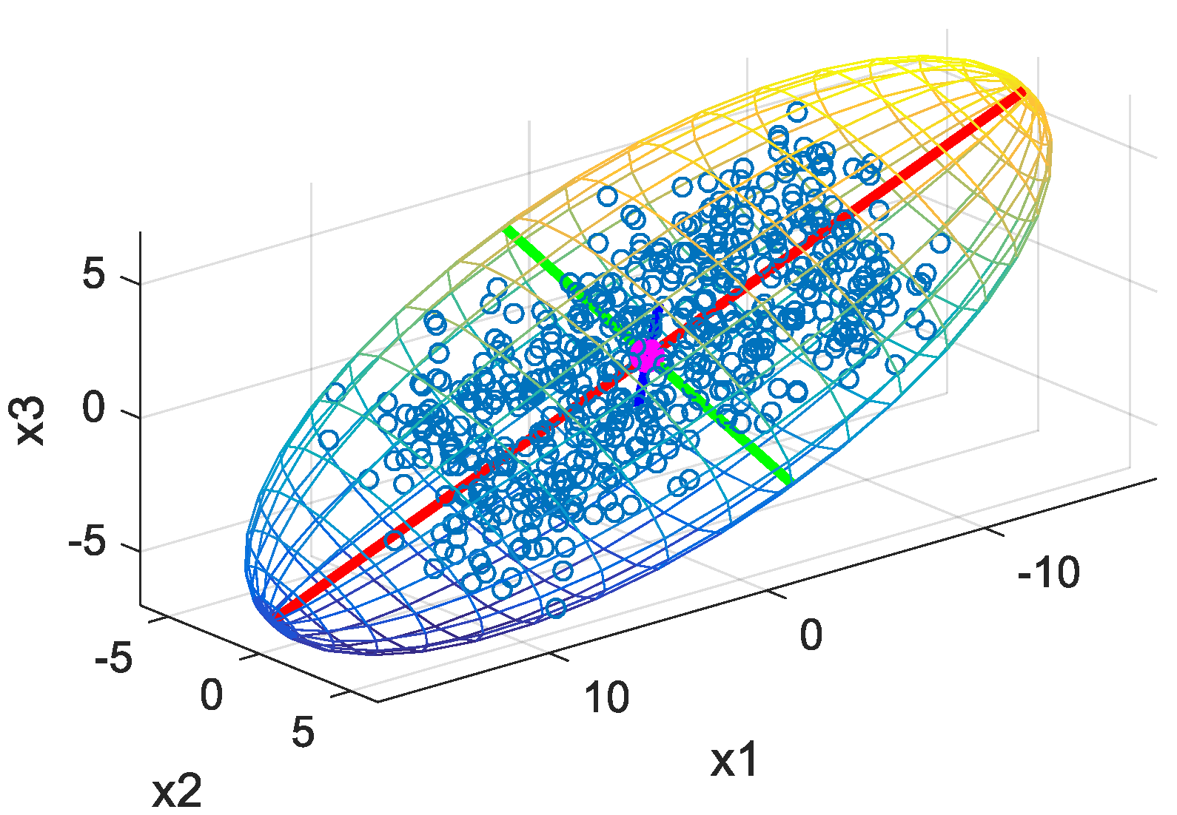
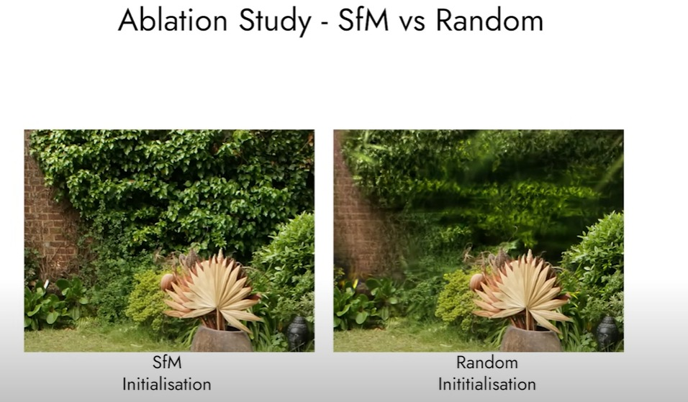
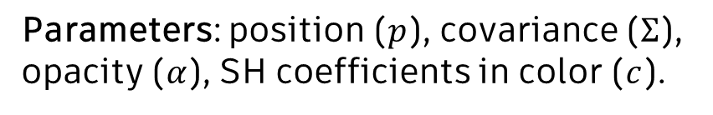
Initializing Gaussian Splats
SfM
Random
Parameters: position ($p$), covariance ($Σ$), opacity ($α$), SH coefficients in color ($c$).
B. Kerbl et al., “3D Gaussian Splatting for Real-Time Radiance Field Rendering”, ACM Trans. Graph., vol 42, nº4, 2023;

Slide 18
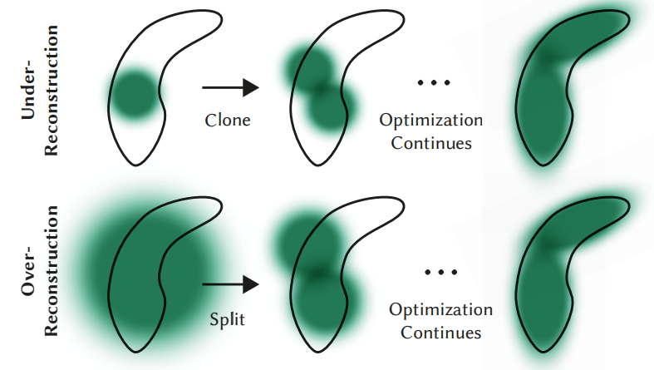
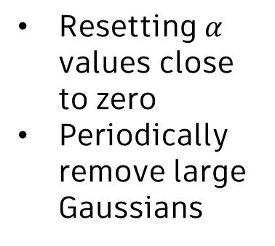
Parameter optimization
Principle: successive iterations of rendering and comparing the results to training.
In order to do that, Adaptive Density Control is used.
Warm-up cycles
(lower definition images)
Densify in batches, considering transparency thresholds
Resetting $α$ values close to zero
Periodically remove large Gaussians
Final render

Slide 19
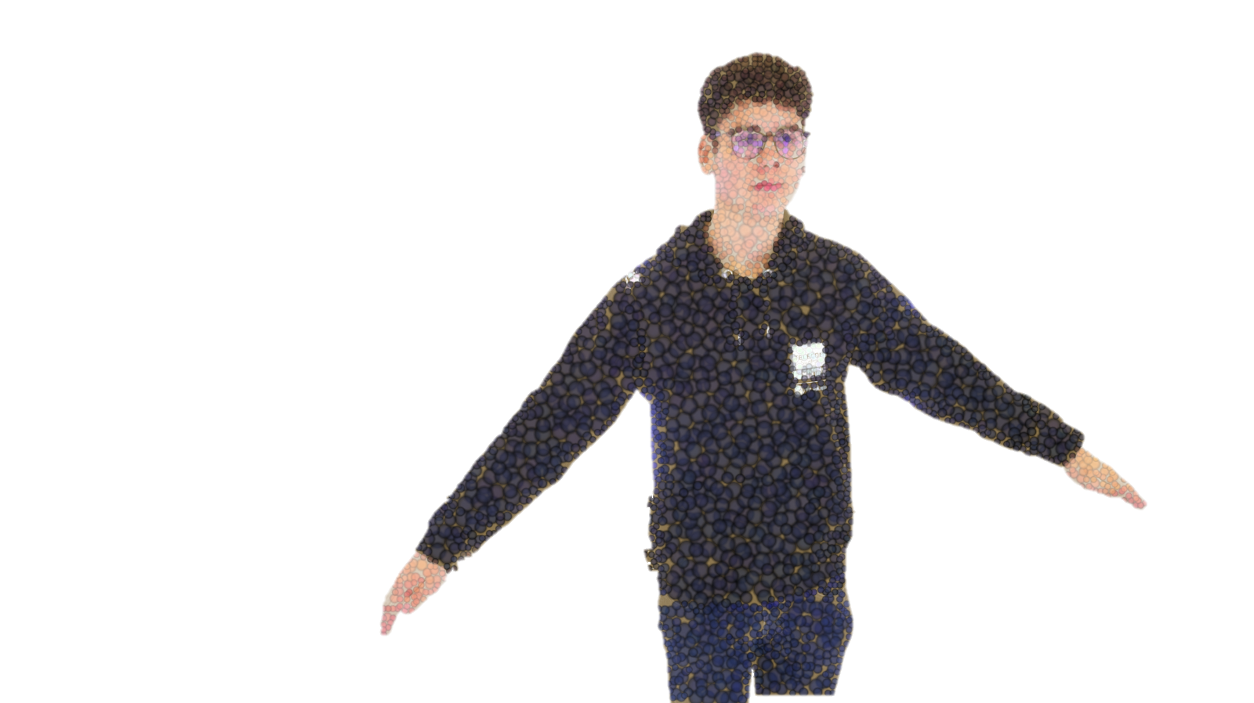
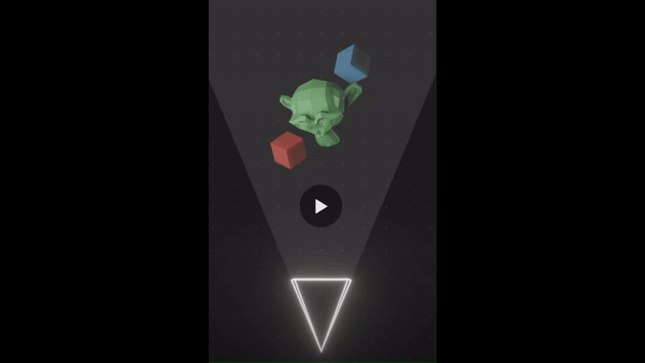
Rasterization

Slide 20
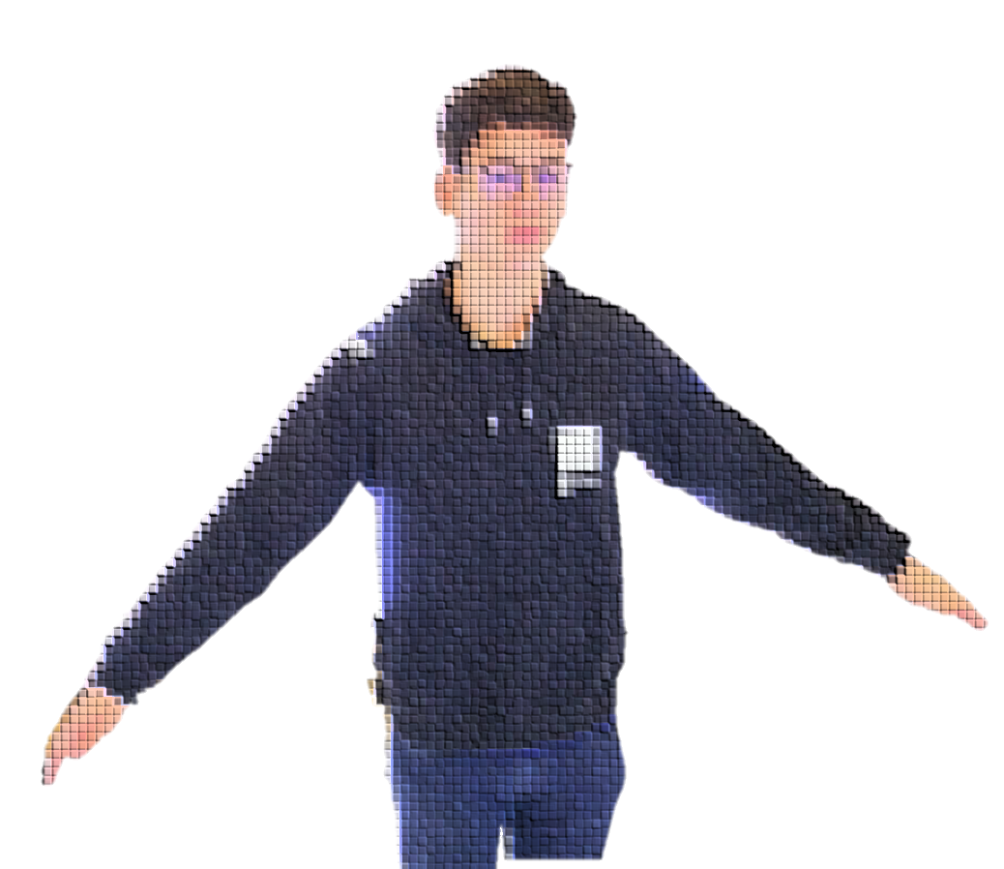
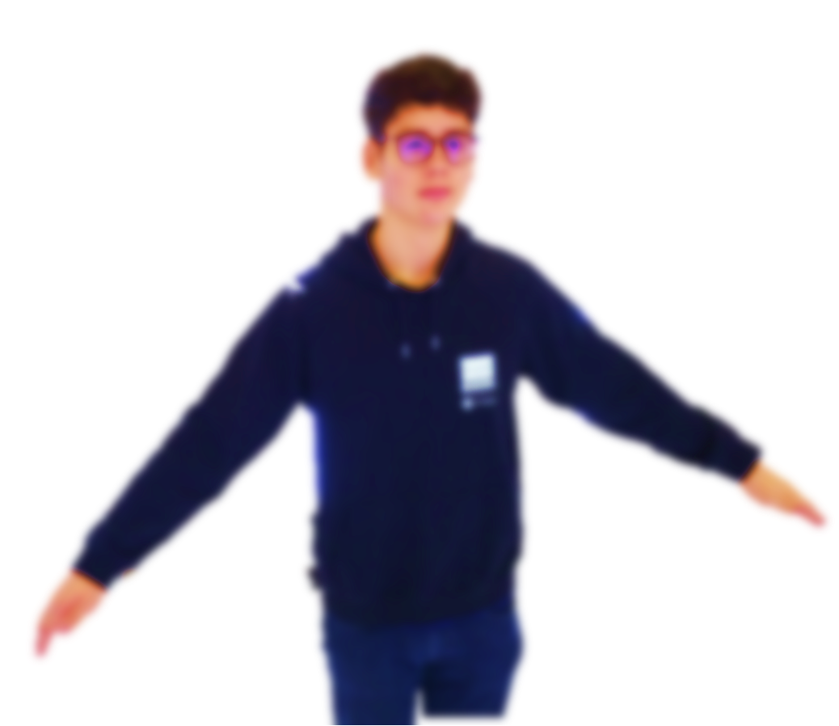

Rasterization
Calculate contributions from gaussians to pixels
$α$-blending
Projection

Slide 21
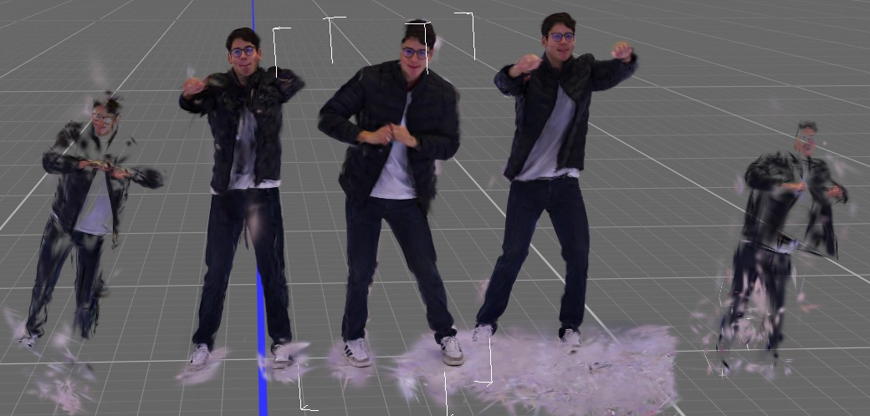
Gaussian Splatting - Results

Slide 22
Gaussian Splatting - Results

Slide 23
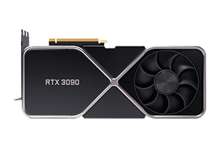
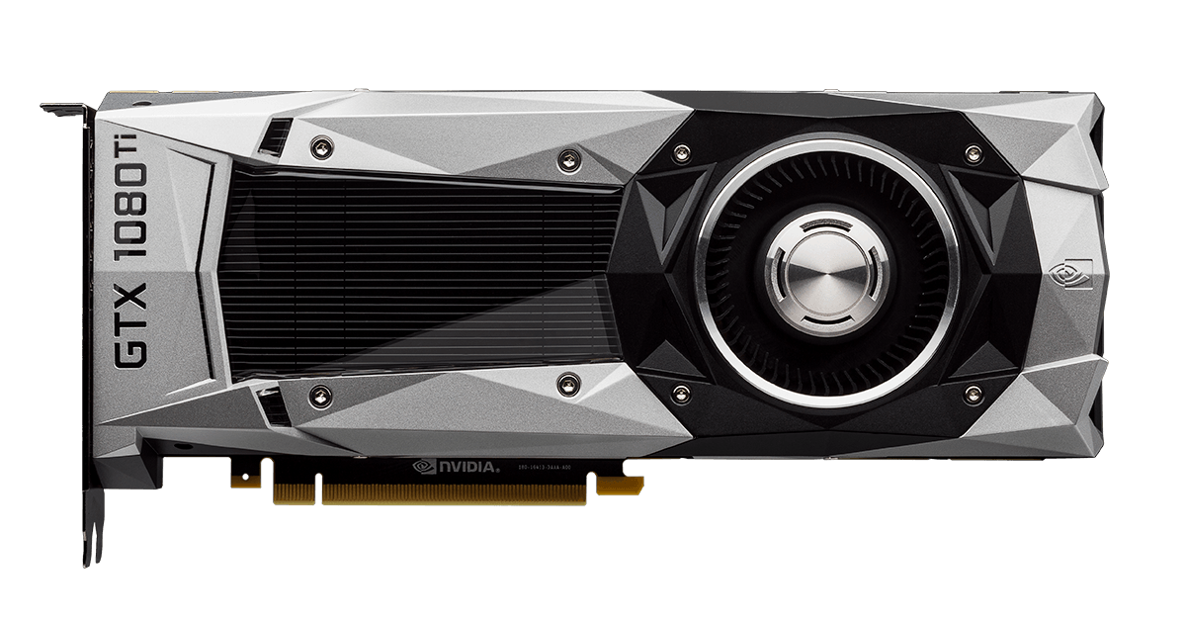
Challenges
The deployment process was long and difficult. Only after weeks of trying were we able to process the data to produce a .ply file;
Our initial GPU wasn’t suficiente for our project;
Not all splats generated were useable, since some resulted in sparse points far from our target (person);
SplatFacto/
Colmap adaptation
Reading
NerfFacto
GSplat
Week 1
Week 2
Week 3
Week 4

Slide 24
Conclusion, next steps and feeback
Conclusion
Understood and discussed some of the literature on 3D image processing;
Implemented one of the SOTA algorithms of 3DGS with our own dataset;
Created a code to process sequential photos to make 4DGS;
Next steps
Build processed objects to correct dimensions and proportions;
Reproduce videos with higher number of images and higher FPS;
Goal: 30 fps for 10 seconds;
Feedback
Challenging project! Difficult to deploy on our machines and combine with the images on our dataset;
Very interesting to learn details of a field different from ours;

Slide 25
Thank you!
IMA4202 – Computer Vision & Deep Learning, Part 2

Slide 26
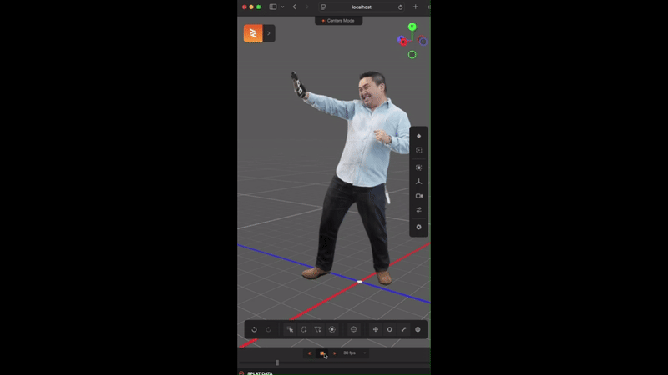
Appendix

Slide 27
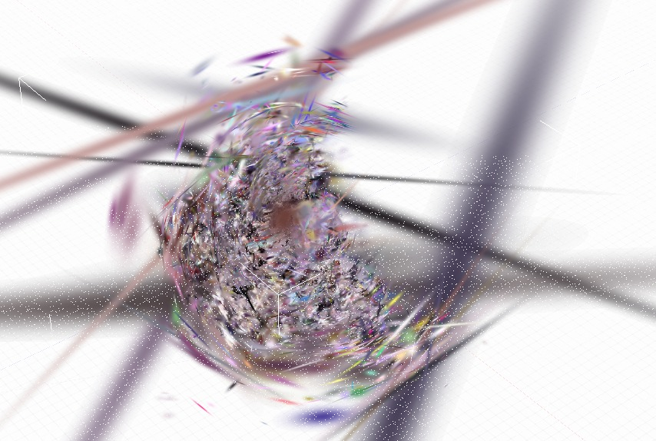
Appendix

Slide 28
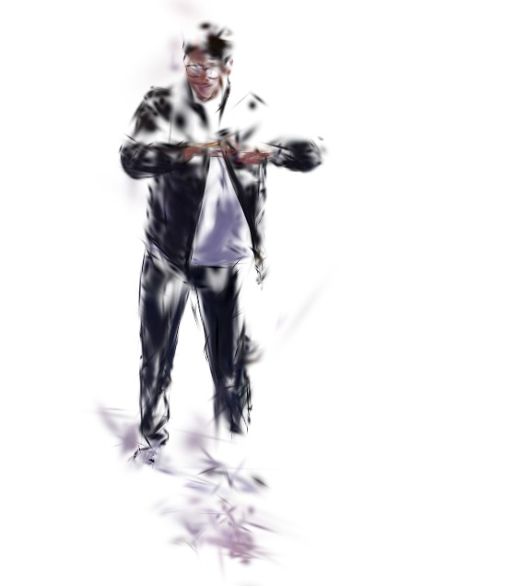
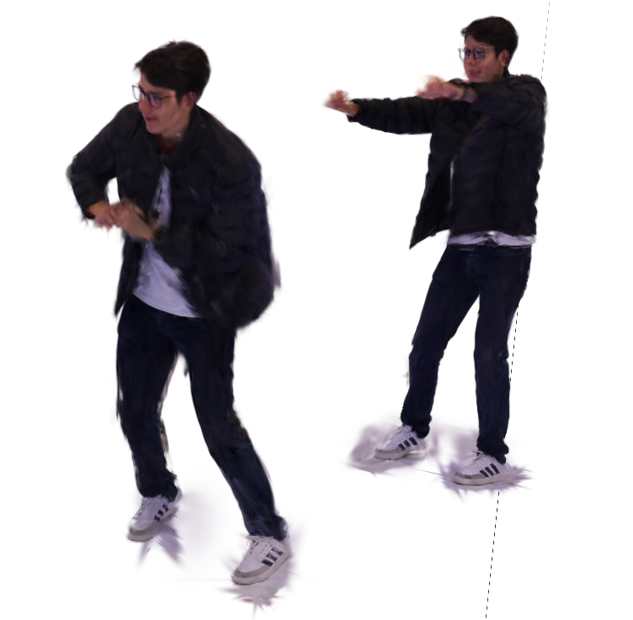
Appendix
VS

